Slide 1
ADSA-2022
Dynamic Programming

Slide 2
Introduction
Divide and conquer
Partition the problem into independent subproblems
Solve the subproblems recursively
Combine the solutions to solve the original problem.
Dynamic programming solves every subproblem just once and stores the answer in a table.
Main approach: recursive, holds answers to a sub problem in a table, can be used without recomputing.
It follows a bottom-up technique by which it start with smaller and hence simplest subinstances.

Slide 3
Dynamic Programming
A dynamic-programming algorithm solves each subsubproblem just once and then saves its answer in a table, thereby avoiding the work of recomputing the answer every time it solves each subsubproblem.
The technique of storing sub-problem solutions is called memoization
Typically the Dynamic programming is applied to optimization problems (Problems can have many possible solutions)
Steps to delevolp the Dynamic-programming algorithm
Characterize the structure of an optimal solution.
Recursively deﬁne the value of an optimal solution.
Compute the value of an optimal solution, typically in a bottom-up fashion.
Construct an optimal solution from computed information.

Slide 4
Example: Fibonacci numbers
Divide problem into two subproblems to calculate (n-1)th and (n-2)th Fibonacci numbers
Problem:
Let’s consider the calculation of Fibonacci numbers:
F(n) = F(n-2) + F(n-1)
with seed values F(1) = 1, F(2) = 1
or F(0) = 0, F(1) = 1
What would a series look like:
0, 1, 1, 2, 3, 4, 5, 8, 13, 21, 34, 55, 89, 144, …
https://www.cs.usfca.edu/~galles/visualization/DPFib.html

Slide 5
Example:2
Divide and Conquer
Recurrence relation:
T(n) = T(n-1) + T(n-2) + o(1)
Time Complexity: O( 2^(n/2))
Recursive Algorithm:
Fib(n)
{
if (n == 0)
return 0;
if (n == 1)
return 1;
Return Fib(n-1)+Fib(n-2)
}

Slide 6
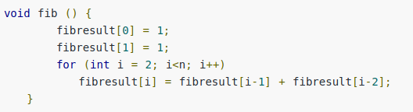

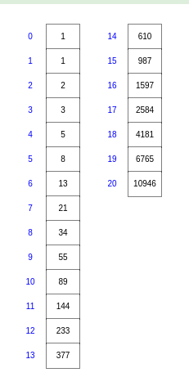
Using Dynamic Programming approach with memoization:
Use same recurrence relation and store the results of the problem that solved. i.e Memorize these result in an array

Slide 7
Example: Rod cutting
Dynamic programming to solve a simple problem in deciding where to cut steel rods.
Serling Enterprises buys long steel rods and cuts them into shorter rods, which it then sells. Each cut is free.
Serling Enterprises to know the best way to cut up the rods
We are given prices p_{i} and rods of length i:
length i 1 2 3 4 5 6 7 8 9 10
price p_{i}
1 5 8 9 10 17 17 20 24 30
Question: We are given a rod of length n, and want to maximize revenue, by cutting up the rod into pieces and selling each of the pieces

Slide 8

Example: Rod cutting
We’ll first list the solutions:
1.) Cut into 2 pieces of length 2:
2.) Cut into 4 pieces of length 1:
3-4.) Cut into 2 pieces of length 1 and 3 (3 and 1):
5.) Keep length 4:
6-8.) Cut into 3 pieces, length 1, 1 and 2 (and all the different orders)
Total: 8 cases for n = 4 (= 2^{n-1}). We can slightly reduce by always requiring cuts in non-decreasing order. But still a lot!
length i 1 2 3 4 5 6 7 8 9 10
price p_{i}
1 5 8 9 10 17 17 20 24 30

Slide 9
Example: Rod cutting
Note: We’ve computed a brute force solution; all possibilities for this simple small example. But we want more optimal solution!
One solution:
recurse on further
i
n-i
What are we doing?
- Cut rod into length i and n-i
Only remainder n-i can be further cut (recursed)
We need to define:
a.) Maximum revenue for log of size n: r_{n} (that is the solution we want to find).
b.) Revenue (price) for single log of length i: p_{i}

Slide 10
Example: Rod cutting
Example: If we cut log into length i and n-i:
recurse on further
i
n-i
Revenue: p_{i} + r_{n-i}
Can be seen by recursing on n-i
What are we going to do?
There are many possible choices of i:

Slide 11
Example: Rod cutting
Recursive (top-down) pseudo code:
Problem? Slow runtime (it’s essential brute force)!
But why? Cut-rod calls itself repeatedly with the same parameter values (tree):

Slide 12
Example: Rod cutting
Recursive solution is inefficient, since it repeatedly calculates a solution of the same subproblem (overlapping subproblem).
Instead, solve each subproblem only once AND save its solution. Next time we encounter the subproblem look it up in a hashtable or an array
(Memoization, recursive top-down solution).
We save the solution of subproblems Of increasing size (i.e. in order) in an array. Each time we will fall back on solutions that we obtained in previous steps and stored in an array (bottom-up solution).
Recursive top-down solution: Cut-Rod with Memoization
Step 1 Initialization:
Creates array for holding memoized
results, and initialized to minus infinity.
Then calls the main auxiliary function.

Slide 13
Step 2: The main auxiliary function, which goes through the lengths, computes answers to subproblems and memoizes if subproblem not yet encountered:

Slide 14
Bottom-up solution: Bottom Up Cut-Rod
Each time we use previous values form arrays:
Check if value already known or memoized
v
Compute maximum revenue
if it hasn’t already been
computed.
v
Saving value

Slide 15
Run time:
Run time: For bottom-up and top-down approach O(n²)
Why (double nested loop)?
We can also view the subproblems encountered in graph form.
We reduce the previous tree that included all the subproblems repeatedly
each vertex represents
subproblem of a given size
Vertex label: subproblem size
Edges from x to y: We need
a solution for subproblem x when
solving subproblem y

Slide 16
Run time:
Run time: Can be seen as number of edges O(n²)
Note: Run time is a combination of number of items in table (n) and work per item (n).
The work per item because of the max operation (needed even if the table is filled
And we just take values from the table) is proportional to n as in the number of edges
in graph.

Slide 17
References
https://www.cs.usfca.edu/~galles/visualization/DPFib.html

